Slide 1
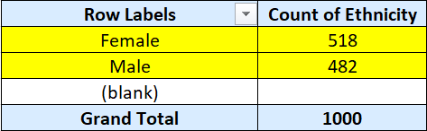
1.Summary of gender and ethnicity distribution
There are a total of 1000 employees are working in this firm out of which 518 are females and 482 are males. From the data given, it is found that there are 404 Asians. In that 207 are females and 197 are males. The number of black employees is 74 from which 37 are females and 37 are males. There are 271 Caucasians in which 140 are females and 131 are males. There are 251 Latinos out of which 134 are females and 117 are males. Hence the firm has a wide range of gender and ethnicity.

Slide 2
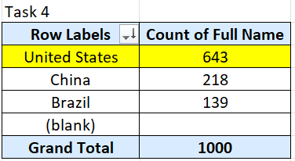
4. Country that has highest number of employees
Using the pivot table, it is found that the United States has the highest number of employees with the count of 643, followed by China and Brazil.

Slide 3
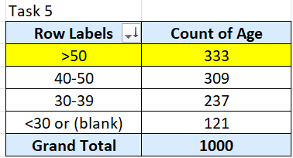
5.Common age range among the employees
Using the pivot table created from the given data sheet, it is found that the common age range in the firm is above 50 which has a employee count of 333, followed by the age range of 40-50.

Slide 4

6. Average bonus percentage given to the employees
Using the pivot table created from the given data sheet, it is found that average bonus given to the employees is 0.08866% annually.

Slide 5
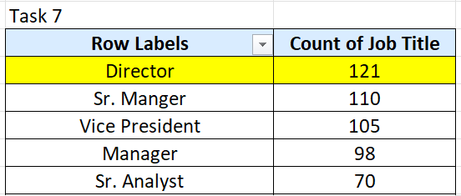
7. Job title that occurs frequently
Using the pivot table created from the given data sheet, it is found that the job title that occurs frequently is Director. It occurs 121 times

Slide 6
8. Primary reasons cited for employee exit
The primary reasons cited for employee exit are 1. Less Salary 2. Very less bonus

Slide 7
9. Departments more diverse
Yes, certain departments are more diverse in terms of ethnicity when compared to others!

Slide 8
10. Hires over the past years
There’s an increase in the number of hires over the past years

